Slide 1
Problem
I like those slides with the faded picture in the background. Can we try something like that?
The social and financial impact of the Coronavirus
Your Customers Expect (3):
Focus on care and concern
Reach out with support, not marketing
50% say they have increased stress and worry (1)
5.2% decrease in the global economy this year (2)
1. Source: https://philanthropyu.org/infographic-covid-19s-effect-on-social-impact-perspectives-from-the-ground/
2 https://www.worldbank.org/en/news/press-release/2020/06/08/covid-19-to-plunge-global-economy-into-worst-recession-since-world-war-ii
3 https://www.mckinsey.com/business-functions/marketing-and-sales/our-insights/adapting-customer-experience-in-the-time-of-coronavirus
Notes:
The global pandemic has affected us all. Feelings of isolation, depression and anxiety are on the rise. The spread of COVID-19 has caused a global economic recession. In response, customers expect businesses to find new, compassionate ways to connect with them online.

Slide 2
Solution
This is an embedded video. The text just describes the voice over and the [] give suggestions for the content.
Video:
Interactive ai trained on techniques that are demonstrated effective at lowering stress and anxiety [show conversing with Lee]
The AI establishes a connection and gets permission to make customized suggestions [show making a recommendation and bringing up the calculator]
Linear optimizer is programmed to make creative suggestions for reaching personal goals with the minimum hardship [show adding a category, making selections and getting updates]
Improve the intelligence with access to transaction history and special-purpose knowledge bases [highlight the Ulster Bank button]
Notes:
Our solution is to build an artificial intelligence that listens and makes helpful suggestions. The interactive AI is trained on techniques that have been demonstrated effective at lowering stress and anxiety. The AI establishes a connection and gets permission from customers to make personalized suggestions. We use a linear optimizer to find creative suggestions for reaching personal goals with minimum hardship. Customers can improve the intelligence by connecting to their transaction history and to special-purpose knowledge bases.

Slide 3
Solution
Use Icons. Animate this showing the left side first, then the right side.
*Based on work with Naresh Vyas in the Applied AI Studio
Open core
Custom Extensions*
To better serve your customers
To reach out to anyone
Historical Transaction Data
Web App
Bank APIs
Flask
UI
AI
Custom Knowledge Base
Demographic Spending Patterns
Geographic Cost Patterns
iFrame
DialogFlow
Bot
Intents
Notes:
We’ve designed the software as custom extensions to an open core. The core of the software is a Python/Flask application connected to a DialogFlow chatbot. This is all opensource and it can be used to engage both current and prospective customers.
Custom extensions are built from the bank APIs. This idea is based on the work we’ve done in the Applied AI Studio under the guidance of Naresh Vyas. Historical transaction data, and custom knowledgebase data are used to make the AI even more personal and useful. This is a powerful incentive for attracting new customers and retaining existing ones.

Slide 4
Alternatives
Reveal the competitors in an animation with Lee shown last. Use icons, but make ours the biggest.
Lee is the best way to make personal connection without pitching or marketing
Professional Services
Personal
Lee
Personalized advice from experts
Use AI to make a connection and solve real problems
Pitching/Marketing
Support
Calculators
Premium Tools
General Content
Premium Content
Provide limited access to premium insight
Make best practices generally available
General
Notes:
This solution is one of the best ways to use the digital channel to show customers care and concern without marketing to them. It provides a unique balance of open access and personal relevance.

Slide 5
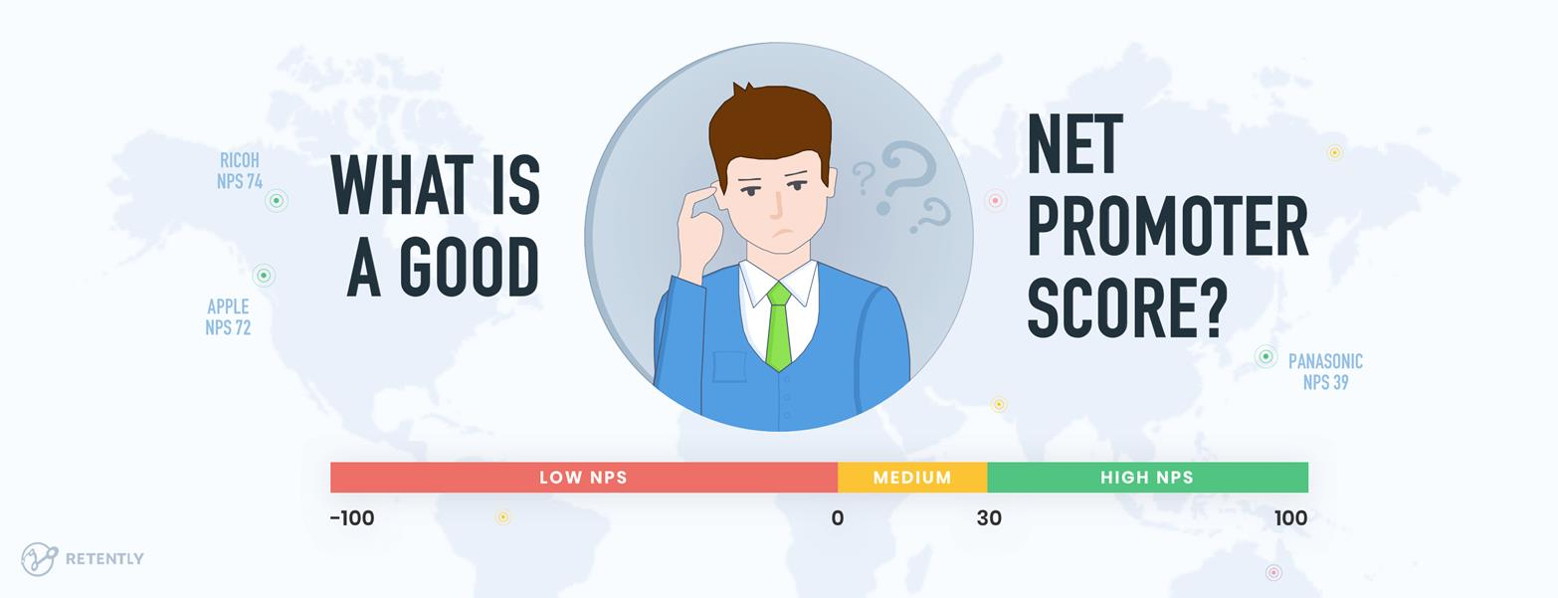
Business Model
Lee in creases your company’s net promoter score (NPS)
There is a strong link between organic growth and a company’s Net Promoter Score. (1)
In our beta test, the techniques used in Lee resulted in an 80 NPS
For financial services companies lifetime value of a promoter is 2.5 times higher than that of a detractor (2)
(1) https://www.netpromotersystem.com/about/how-net-promoter-score-relates-to-growth/
(2) https://customergauge.com/benchmarks/blog/financial-services-nps-benchmarks
Notes:
This solution increases your company’s net promoter score (NPS). Before the event, we beta-tested this technique and the result was an 80 NPS. For financial services companies, the lifetime value of a promoter is more than twice that of a detractor.

Slide 6
Team
[Screenshot]
Demo: https://hello-lee.herokuapp.com/
Team DXC
[screenshot of the repo]
Open Source Code: https://github.com/dxc-technology/AI-Remote-Worker-Assistant
[with pictures]
Om Prakash Singh
Hitesh Kumar
Angeli Mae Trinidad
Hemanth Kum Arikatla
Jerry Overton
Notes:
Our team comes from DXC’s Applied AI Studio:
Om Singh
Hitesh Kumar
Angeli Trinidad
Hemanth Arikatla
And I’m Jerry Overton
We’ve published a demo so that you can try the solution yourself. We’ve open-sourced the project and so that we can build a community contributors.

Slide 7
Closing
Show an animation revealing the roadmap from start to finish.
Next Steps: Roadmap to implementation
Hackathon Alpha Open Source release
Contributor days
Beta release
Open Release 1
API-specific Release 2
[Show as a roadmap or progression of steps]
Notes:
In the road ahead, we’ll build the code into a beta release. We’ll use what we learned from the beta to launch release 1. Release 2 will be the custom, proprietary extensions the open core of Release 1.
Thanks so much to Ulster Bank, DogPatch Labs, and the NatWest Group for the Ulster Bank 2020 Hackathon.

